Slide 1
Hebbian Learning Rule

Slide 2
Introduction to Hebbian model
It is one of the first and also easiest learning rules in the neural network
It is used for pattern classification.
It is a single layer neural network, i.e. it has one input layer and one output layer.
The input layer can have many units, say n. The output layer only has one unit.
Uses the bipolar sigmoidal function as activation function with output range as [-1, 1]
Hebbian rule works by updating the weights between neurons in the neural network for each training sample.

Slide 3
Hebbian Learning Algorithm
Set all weights to zero, w_{i} = 0 for i=1 to n, and bias to zero.
For each input vector, S(input vector) : t(target output pair), repeat steps 3-5.
Set activations for input units with the input vector X_{i} = S_{i} for i = 1 to n.
Set the corresponding output value to the output neuron, i.e. y = t.
Update weight and bias by applying Hebb rule for all i = 1 to n:
If two interconnected neurons are both “on” at the same time, then the weight between them should be increased
w_{i}(new) = w_{i}(old) + x_{i}y
b(new) = b(old) + y

Slide 4
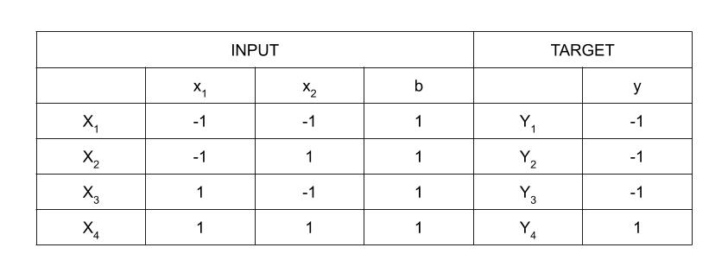
Implementing AND gate

Slide 5
Computation
Step 1 :
Set weight and bias to zero, w = [ 0 0 0 ]^{T} and b = 0.
Step 2 :
Set input vector X_{i} = S_{i} for i = 1 to 4.
X₁ = [ -1 -1 1 ]^{T}
X₂ = [ -1 1 1 ]^{T}
X₃ = [ 1 -1 1 ]^{T}
X₄ = [ 1 1 1 ]^{T}
Step 3 :
Output value is set to y = t.
Step 4 :
Modifying weights using Hebbian Rule

Slide 6
Modifying weights using Hebbian Rule
First iteration –
w(new) = w(old) + x₁y₁ = [ 0 0 0 ]^{T} + [ -1 -1 1 ]^{T} . [ -1 ] = [ 1 1 -1 ]^{T}
For the second iteration, the final weight of the first one will be
used and so on.
Second iteration –
w(new) = [ 1 1 -1 ]^{T} + [ -1 1 1 ]^{T} . [ -1 ] = [ 2 0 -2 ]^{T}
Third iteration –
w(new) = [ 2 0 -2]^{T} + [ 1 -1 1 ]^{T} . [ -1 ] = [ 1 1 -3 ]^{T}
Fourth iteration –
w(new) = [ 1 1 -3]^{T} + [ 1 1 1 ]^{T} . [ 1 ] = [ 2 2 -2 ]^{T}
So, the final weight matrix is [ 2 2 -2 ]^{T}

Slide 7
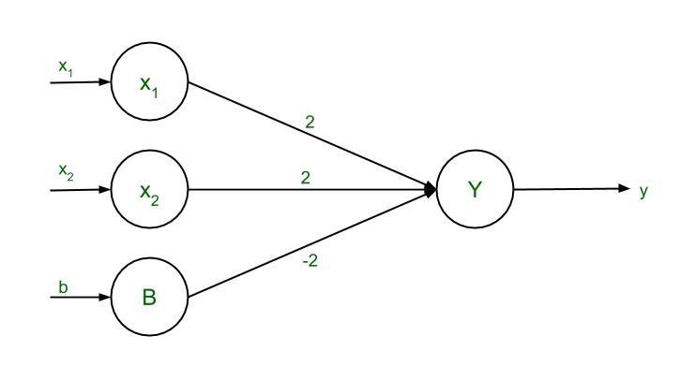
Testing the network
For x₁ = -1, x₂ = -1, b = 1, Y = (-1)(2) + (-1)(2) + (1)(-2) = -6
For x₁ = -1, x₂ = 1, b = 1, Y = (-1)(2) + (1)(2) + (1)(-2) = -2
For x₁ = 1, x₂ = -1, b = 1, Y = (1)(2) + (-1)(2) + (1)(-2) = -2
For x₁ = 1, x₂ = 1, b = 1, Y = (1)(2) + (1)(2) + (1)(-2) = 2

